Slide 1

Salvador Galán Brenes
Tarea Modulo 20

Slide 2
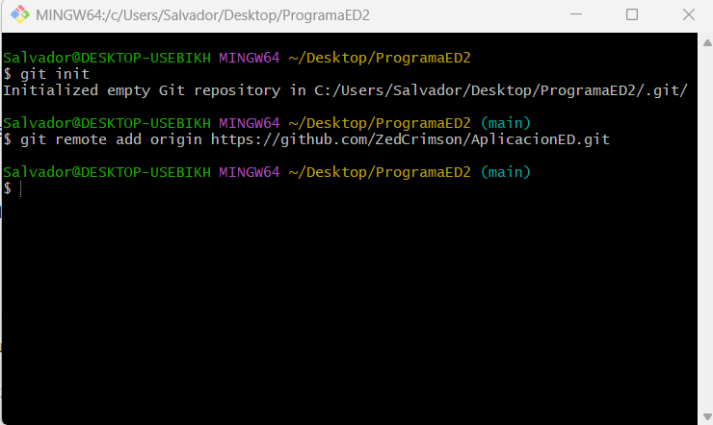
Initialization

Slide 3
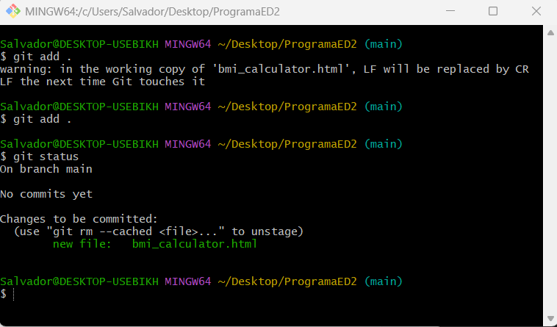
Commit

Slide 4
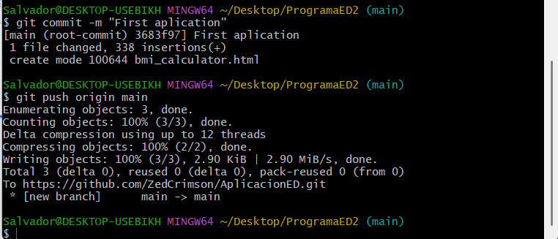

Slide 5


Slide 6
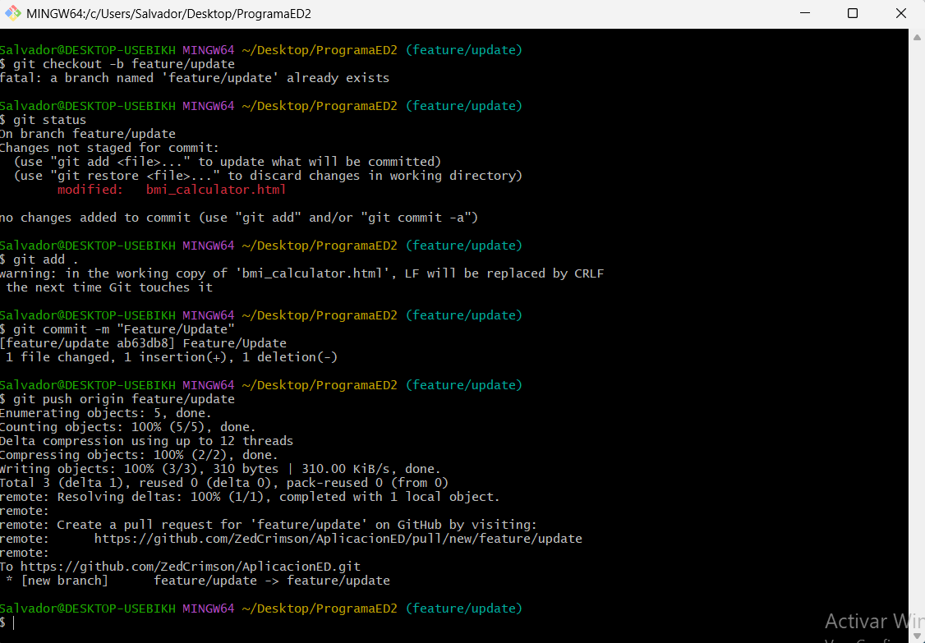
Branching

Slide 7
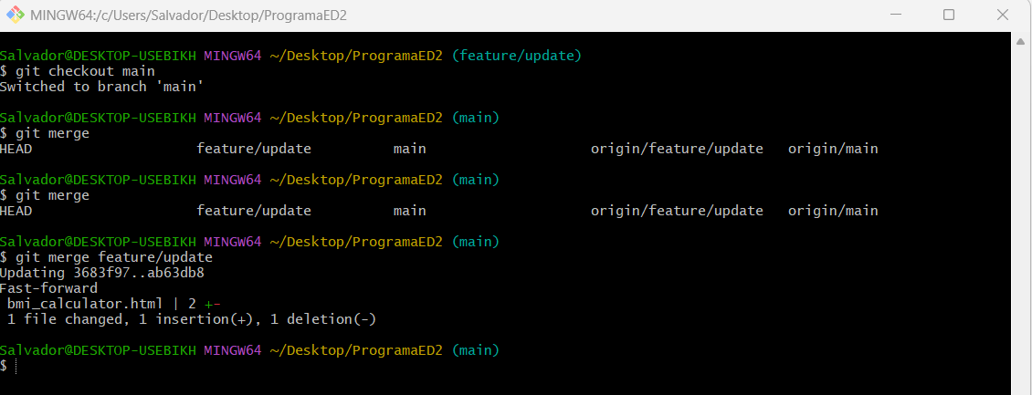
Deployment

